Slide 1
The Changing Face of MOOCs
Hugh Davis:
@HughDavis
July 2013

Slide 2
This Talk
What are MOOCs?
What’s the business model?
What/who are MOOCs for?
Futurelearn
How the education community is reacting to MOOCs
What does it take to make a MOOC?
In what ways are MOOCs predicted to change education?
Not going
to talk
About
Pedagogy

Slide 3
What is a MOOC?
Massive - some have 10,000s registered.
Open = free anyone can register
Online although many have a parallel blended incarnation
Course - that runs at a given time with a given cohort (but not necessarily accredited for anything)
-
Different to OERs

Slide 4
Most Courses consist of
Many short videos
Some talking heads
Some “worked examples”
Some experiments etc.
On-line papers etc.
Discussion forums
On-line activities
Formative assessments
Assessment (and feedback) will need to be
Objective (multiple choice etc.)
Peer review
Self evaluation
Learning Design Workflow and Learning Analytics are central
The emphasis must be on the student as a self-motivated learner.

Slide 5
Why MOOC?

Slide 6
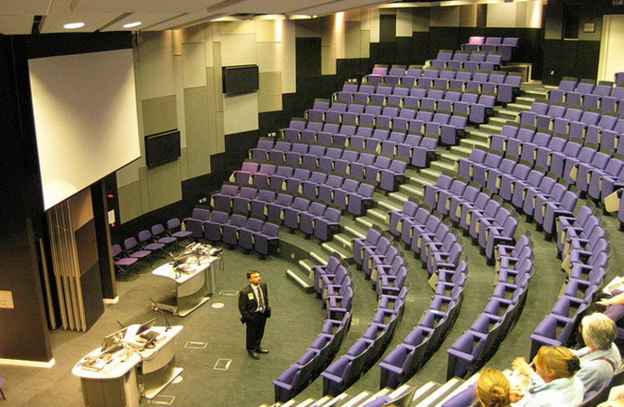

Motivations for making MOOCs
enhance reputation
boost recruitment
provide a public service
create more flexible routes for entry
explore new markets
support collaborative provision
improve on-line capability
enable us to become more agile and flexible

Slide 7
New Markets
Formal
Learning
Modules
Formal
Learning
Whole
Programmes
Informal
Learning
YouTube,
iTunesU
Non Formal
Learning
MOOCs
OERs
Pulling Students through from the Informal to the Formal

Slide 8

How do MOOCs make money?
Certifications
Authenticated assessments
Human tutoring
Corporate learning
Sponsorship
Access to student records

Slide 9
Who MOOCs

Slide 10
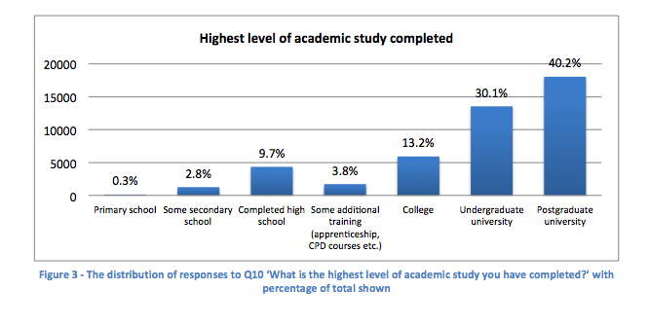
Demographics of Edinburgh’s MOOCs
(MOOCs @ Edinburgh 2013 - Report #1)

Slide 11




MOOC Providers
Udacity the first “democratizing education” but still for profit. Started at Stanford.
Coursera for profit but business model only just emerging 2,000,000 people have taken a course, from the catalogue of around 200. Only 7-9% complete.
EdX not for profit MIT, Harvard, Berkeley
Futurelearn for profit Based in UK at OU aspires to include top 30-40 universities Director is Simon Nelson - responsible previously for BBC digital strategy

Slide 12



Slide 13
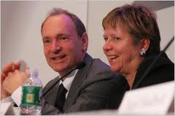


Working with Futurelearn
What courses to offer?
The answer is in differentiation
Southampton intends to offer Web Science and Oceanography based MOOCs as its first offerings..

Slide 14

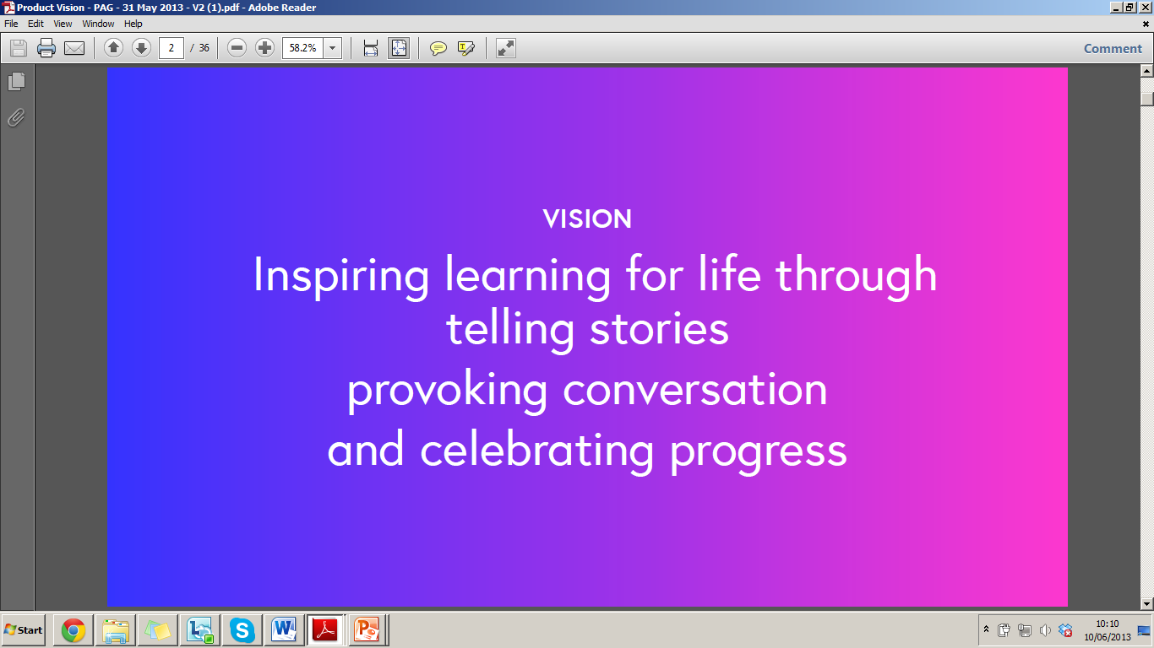
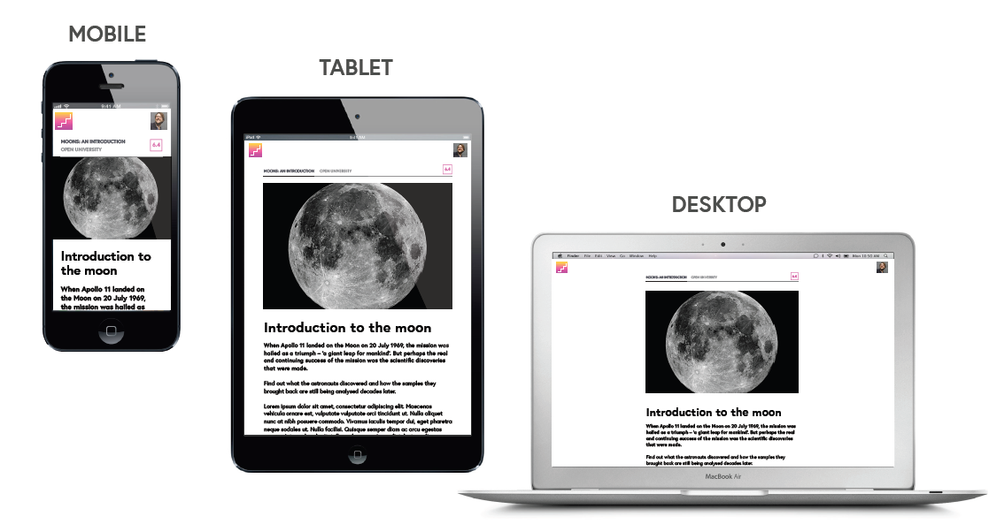
PRODUCT VISION
Designed for mobile, tablets and desktop
Notes:
Claire

Slide 15
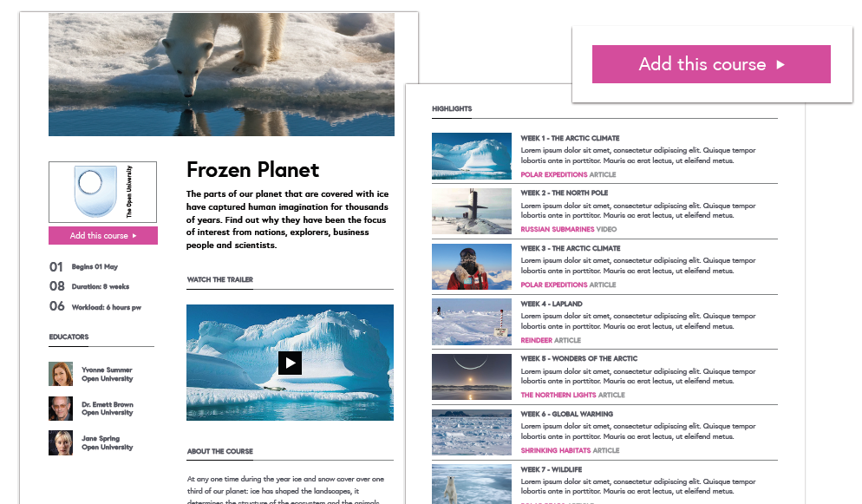
PRODUCT VISION
Course details page

Slide 16
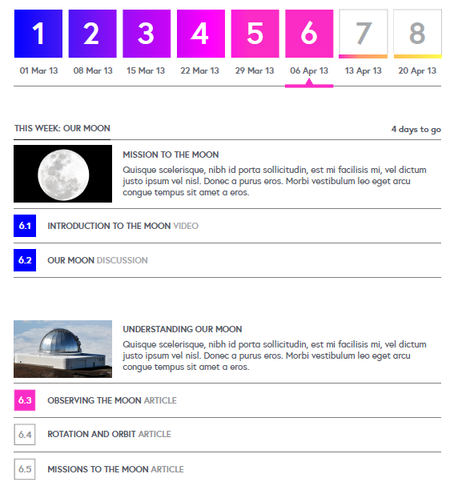
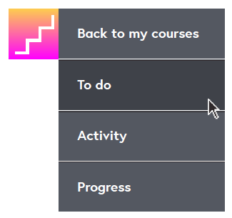
PRODUCT VISION
To do list

Slide 17
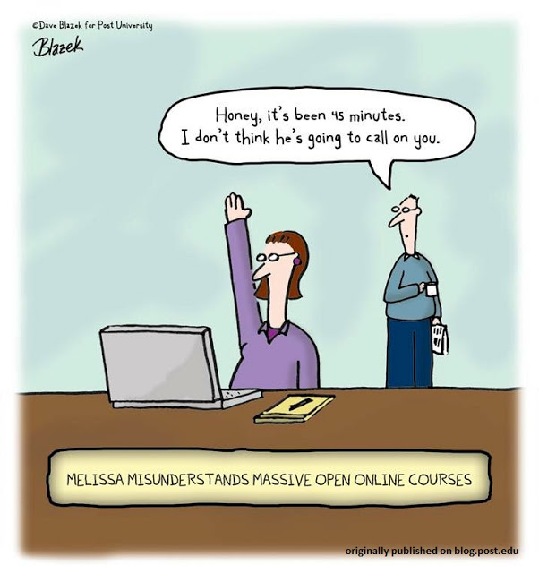
Patterns for Social Learning
Social constructivist learning approach
Based on small on-the-fly groups
Students remain in those groups for that activity
Carousel Learning
Lots of ideas for patterns of social learning
Post University cartoon/Dave Blazek, licensed under
a Creative Commons Attribution-NoDerivs 3.0

Slide 18

Why the Avalanche Alert?
Barber, M. Donnelly, K & Rizvi, S. (March 2013).
An Avalanche is Coming; Higher Education and the Revolution Ahead.
Institute for Public Policy Research.

Slide 19
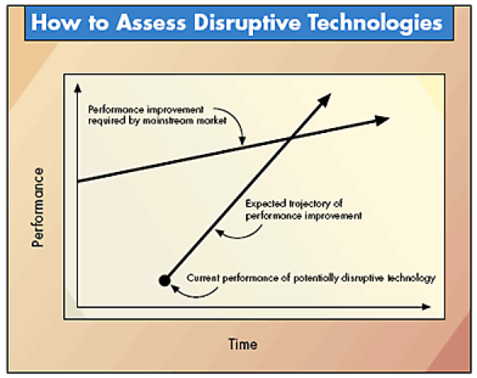
Disruptive Technologies
Joseph L. Bower and Clayton M. Christensen
Disruptive Technologies: Catching the Wave
Harvard Business Review 1995

Slide 20
The cost of a degree is rising in real terms while the value of a degree is falling
The classic university is educating for 20th century skills
Content is ubiquitous
(and free)
Employers attitudes to formal qualifications are changing in favour of demonstration of skills
Private providers can produce cheaper qualification routes
(or wish to be allowed to)
The three of four year degree course is no longer standard
The world distribution of wealth means that most potential students cannot afford higher education
Contract cheating makes current education meaningless
It would not be possible to build enough universities to educate the emerging Chinese market
Education is having its Napster moment

Slide 21

We need to maintain the Goldstandard
Students are looking for so much more out of an university than just formal learning
The best possible education is face to face with a true subject expert
STUDENTS
Contract Cheating shows that you need to examine face to face
We are signing our own death warrants
The hand-wringing citation of unemployment statistics and rising student fees comes not from the unemployed and poor, but from the new education industry that wants to find a way into the marketplace.
Disgraceful MOOC drop-out rates
We’re under fifteen feet of pure white snow

Slide 22




End of the campus...?
Challenge is to optimise the campus experience by embracing the digital movement, and freeing up the timetable to allow for higher quality contact time
I don’t think so
Clicks
AND
Bricks

Slide 23



MOOCs = more choice & flexibility
And meanwhile we are developing our capacity to develop high quality on-line courses

Slide 24
Making MOOCs

Slide 25
MOOC Structure
Learning Unit
1
Learning Unit
2
Learning Unit
3
Learning Unit
4
Learning Unit
5
Learning Unit
6
Up to 10
Learning Unit
1
Learning Unit
2
Up to 3
miniMOOCs have 2 or 3 Learning Units
Learning Unit
n
Weekly Learning Units: , 2- 6 hours study time
Meaningful title, clear learning goals, end-of-unit assessment
1
2
3
Each with 2 or 3 self-contained Learning Blocks
Learning Block
Learning Blocks
Sequence of elements (This is just one example)
Video
Text
Discuss
Quiz

Slide 26
Some Decisions that need to be made
How much?
to spend?
academic time ?
creating the MOOC
at run time
How to structure the course?
pedagogic approach
course resources
amount of video?
create new resources?
use OER?
How to deal with the fact that we can’t use the (licenced) library resources?
How to assess?
How to give feedback?
Video
google hangouts
responses to forum topics
What
tools to use (external?)
social media platforms to use?
So what's the role of the librarian?

Slide 27


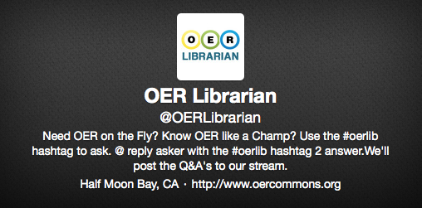
Learning Resources in MOOCs
OERs are allowed
But high quality is required
We need resources that can be accessed by anyone – not just registered students…

Slide 28

Ownership of Materials developed
Who owns the work?
The text book?
What happens if the expert goes?
MOOCs will force us to sort out these issues if not already

Slide 29
Structures
Steering Group
Chief Financial Officer
PVC Ed
Director of Centre of Innovation in Technologies and Education (CITE)
Director of Marketing and Communications
Director of iSolutions
The Librarian
Head of QA
Legal Services
CITE
Learning design
Project management
Video and Multimedia Production
Academic Team
No established model yet
Our Web Science MOOC is involving a team of around 12 academic staff over this summer
The Library
Resource Discovery
Rights clearance
Consultants
Futurelearn Liaison
Providing training
Building platform
Pedagogic patterns
Contracts

Slide 30
The Changing Face of MOOCs

Slide 31
Are MOOCs just stand alone reputational enhancement?
We are in a time of rapid change…
The dialogue now is about MOOCs as part of the eLearning Spectrum
Authentic Assessments leading to credit are now being offered
The QAA want part of the action
The Policy wonks talk of MOOCs as part of the unbundling of the university

Slide 32
MOOCs in campus based learning
External non-paying MOOCers
MOOC
Paying Students

Slide 33
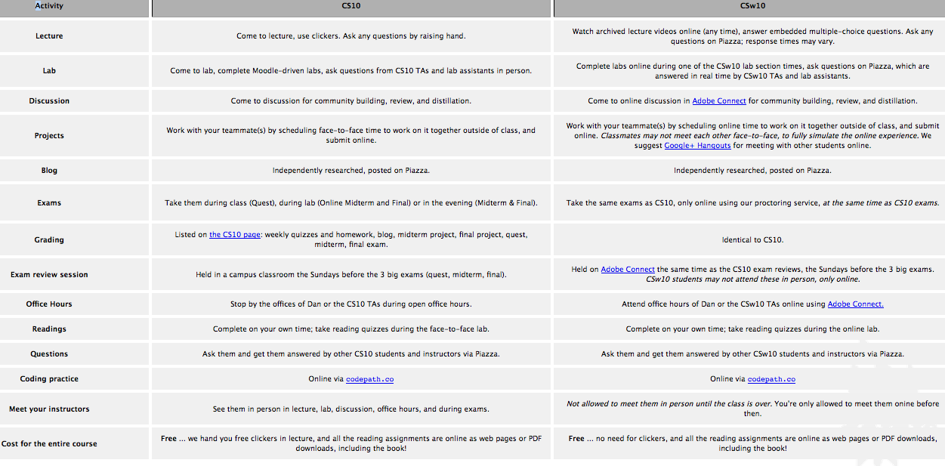
Berkley Scratch Course- shows F2F and MOOC version of course
http://inst.eecs.berkeley.edu/~cs10/fa12/

Slide 34
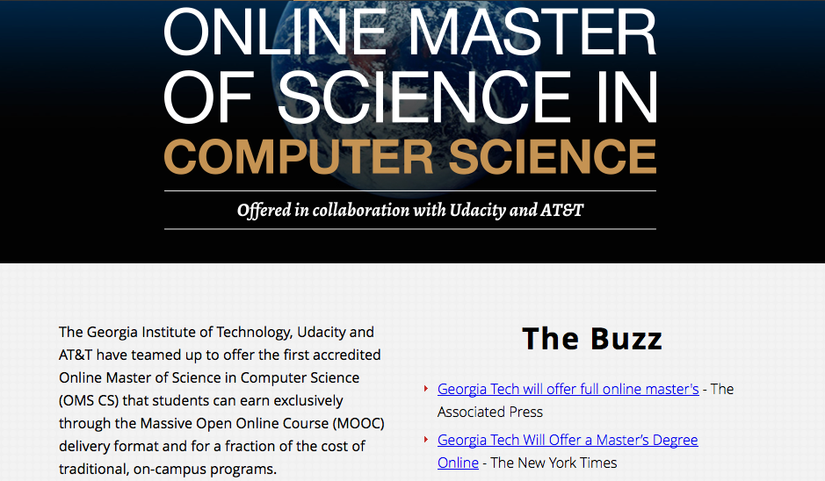
Fully accredited programmes offered as MOOCs

Slide 35
Articulated Degrees
Degree Programme
F2F
Module
MOOC at Stanford
OU
Module
MOOC at Soton
Capstone
Project

Slide 36
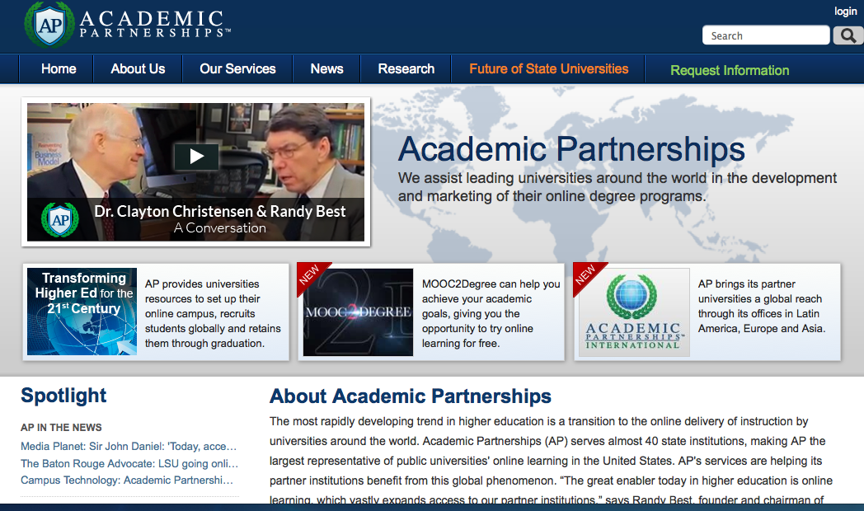


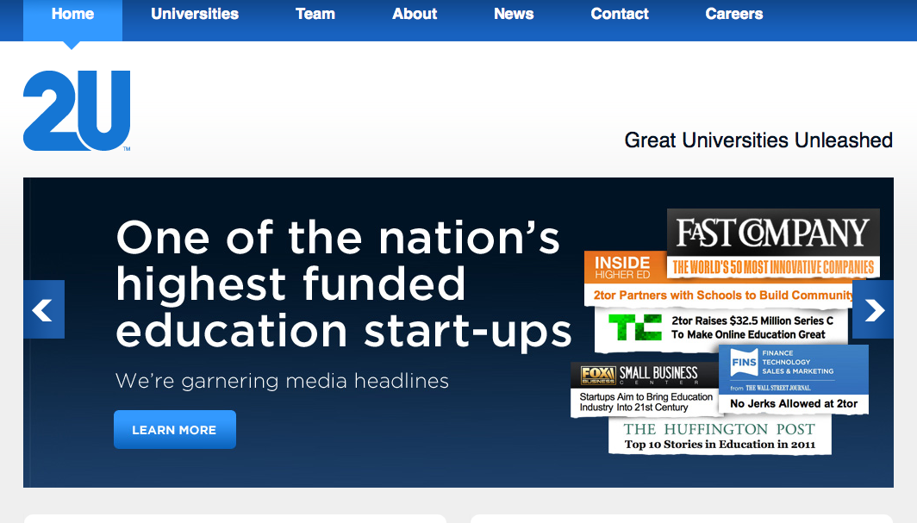
For profit offerings

Slide 37


Final Thoughts from yesterdays Westminster Forum
When employers accept on-line certification then things will really change
There will be many other options than “boarding school degrees”
HE for non-traditional students and for CPD

Slide 38
Thank you Any Questions? Hugh Davis: hcd@soton.ac.uk users.ecs.soton.ac.uk/hcd

